Slide 1
UNIT-2
SML

Slide 2
Comparison between regression and machine learning models
Linear regression and machine learning models both try to solve the same problem in different ways.
Example:
a two-variable equation fitting the best possible plane, regression models try to fit the best possible hyperplane by minimizing the errors between the hyperplane and actual observations.
However, in machine learning, the same problem has been converted into an optimization problem in which errors are modeled in squared form to minimize errors by altering the weights.

Slide 3
Comparison between regression and machine learning models
Machine learning models can be effectively parallelized and made to work on multiple machines in which model weights are broadcast across the machines, and so on.
In the case of big data with Spark, these techniques are implemented.
Statistical models are parametric in nature, which means a model will have parameters on which diagnostics are performed to check the validity of the model.

Slide 4
Comparison between regression and machine learning models
Machine learning models are non-parametric, do not have any parameters, or curve assumptions;
Machine Learning models learn by themselves based on provided data and come up with complex and intricate functions rather than predefined function fitting.

Slide 5
Comparison between regression and machine learning models
Multi-collinearity checks are required to be performed in statistical modeling.
In machine learning space, weights automatically get adjusted to compensate the multi-collinearity problem.
If we consider tree-based ensemble methods such as bagging, random forest, boosting, and so on, multi-collinearity does not even exist, as the underlying model is a decision tree, which does not have a multi-collinearity problem in the first place.

Slide 6
Compensating factors in machine learning models
Compensating factors in machine learning models to equate statistical diagnostics is explained with the example of a beam being supported by two supports.
A similar analogy is applied for comparing statistical modeling and machine learning methodologies here.
The two-point validation is performed on the statistical modeling methodology on training data using overall model accuracy and individual parameters significance test.

Slide 7
Compensating factors in machine learning models
Either linear or logistic regression has less variance by shape of the model itself.
Hence there would be very little chance of it working worse on unseen data.
During deployment, these models do not incur too many deviated results.

Slide 8
Compensating factors in machine learning models
In the machine learning space, models have a high degree of flexibility which can change from simple to highly complex.
On top, statistical diagnostics on individual variables are not performed in machine learning.
Hence, it is important to ensure the robustness to avoid overfitting of the models, which will ensure its usability during the implementation phase to ensure correct usage on unseen data.

Slide 9
Compensating factors in machine learning models
In ML- (train data - 50 percent, validation data - 25 percent, testing data - 25 percent).
Two parts in statistical methodology.
Machine learning models should be developed on training data, and its hyperparameters should be tuned based on validation data to ensure the two-point validation equivalence;
The robustness of models is ensured without diagnostics performed at an individual variable leve.

Slide 10
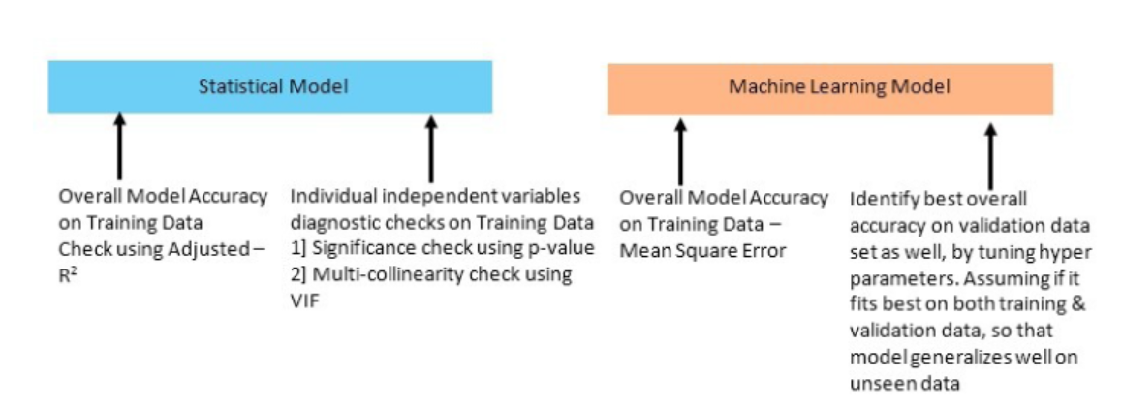
Compensating factors in machine learning models

Slide 11
Assumptions of Linear Regression
Linear regression has the following assumptions, failing which the linear regression model does not hold true:
The dependent variable should be a linear combination of independent variables
No autocorrelation in error terms
Errors should have zero mean and be normally distributed
No or little multi-collinearity
Error terms should be homoscedastic

Slide 12
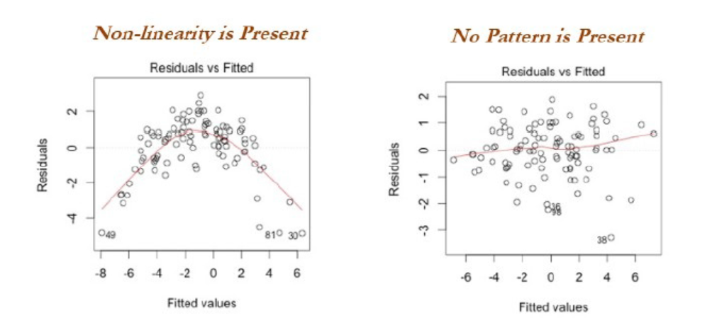
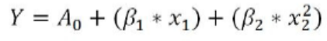
a.) The dependent variable should be a linear combination of independent variables
Y should be a linear combination of X variables. Please note, in the following equation, X2 has raised to the power of 2.

Slide 13
a.) The dependent variable should be a linear combination of independent variables
In sample graph, initially, linear regression was applied and the errors seem to have a pattern rather than being pure white noise.
In this case, it is simply showing the presence of non-linearity.
After increasing the power of the polynomial value, now the errors simply look like white noise

Slide 14
b.) No autocorrelation in error terms:
Presence of correlation in error terms penalized model accuracy.
How to diagnose:
Look for the Durbin-Watson test.
Durbin-Watson's d tests the null hypothesis that the residuals are not linearly auto correlated.
While d can lie between 0 and 4,
if d ≈ 2 indicates no autocorrelation,
0<d<2 implies positive autocorrelation, and
2<d<4 indicates negative autocorrelation.

Slide 15
c.) Error should have zero mean and be normally distributed:
Errors should have zero mean for the model to create an unbiased estimate.
Plotting the errors will show the distribution of errors.
if error terms are not normally distributed, it implies confidence intervals will become too wide or narrow, which leads to difficulty in estimating coefficients based on minimization of least squares.

Slide 16
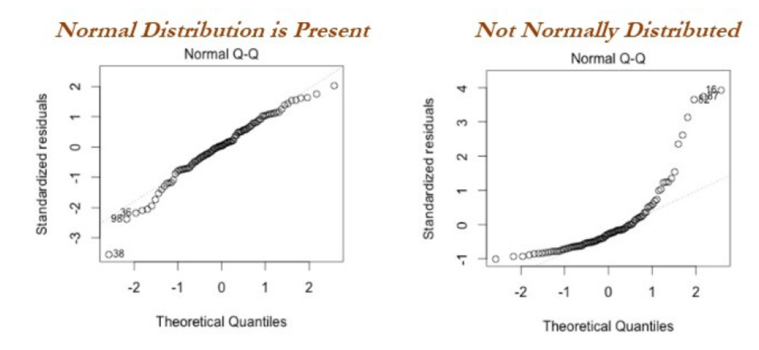
c.) Error should have zero mean and be normally distributed:

Slide 17
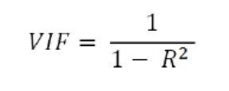
d. No or little multi-collinearity
Multi-collinearity is the case in which independent variables are correlated with each other and this situation creates unstable models by inflating the magnitude of coefficients/estimates.
It also becomes difficult to determine which variable is contributing to predict the response variable.
VIF is calculated for each independent variable by calculating the R-squared value with respect to all the other independent variables.

Slide 18
e. Errors should be homoscedastic
Errors should have constant variance with respect to the independent variable, which leads to impractically wide or narrow confidence intervals for estimates, which degrades the model's performance.
One reason for not holding homoscedasticity is due to the presence of outliers in the data, which drags the model fit toward them with higher weights:

Slide 19
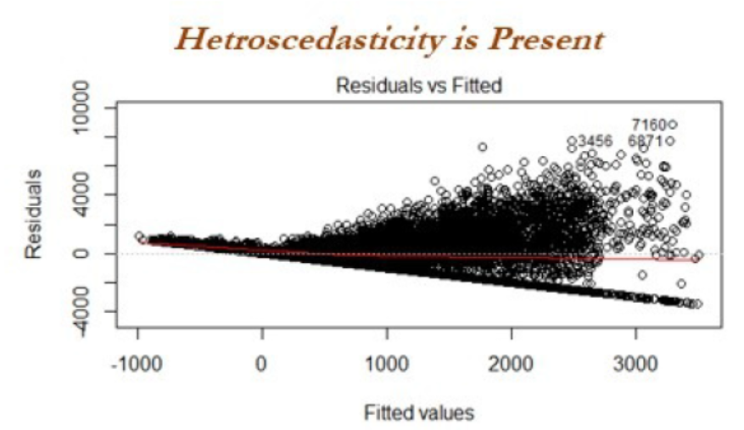
e. Errors should be homoscedastic

Slide 20
Steps applied in Linear Regression Modeling
1. Missing value and outlier treatment
2. Correlation check of independent variables
3. Train and test random classification
4. Fit the model on train data
5. Evaluate model on test data

Slide 21
Example of simple linear regression from first principles

Slide 22
Machine Learning Models- Ridge and Lasso Regression
In linear regression, only the residual sum of squares (RSS) is minimized
In ridge and lasso regression, a penalty is applied (also known as
shrinkage penalty) on coefficient values to regularize the coefficients
with the tuning parameter λ.

Slide 23
Ridge Regression
Ridge regression is a model tuning method that is used to analyse any data that suffers from multicollinearity.
This method performs L2 regularization. When the issue of multicollinearity occurs, least-squares are unbiased, and variances are large, this results in predicted values to be far away from the actual values.
The cost function for ridge regression:
Min(||Y – X(theta)||^2 + λ||theta||^2)
Lambda is the penalty term.
λ given here is denoted by an alpha parameter in the ridge function.
So, by changing the values of alpha, we are controlling the penalty term. Higher the values of alpha, bigger is the penalty and therefore the magnitude of coefficients is reduced.

Slide 24
Ridge Regression
It shrinks the parameters. Therefore, it is used to prevent multicollinearity
It reduces the model complexity by coefficient shrinkage

Slide 25
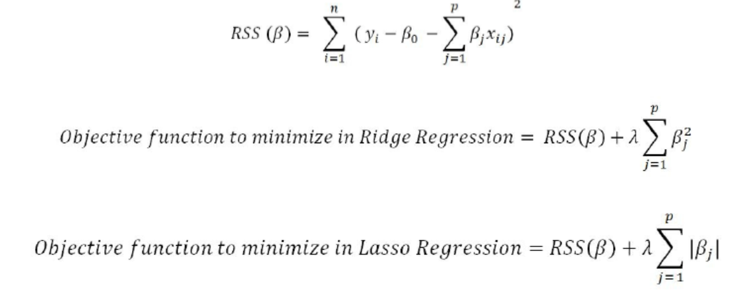
Ridge Regression
When λ=0, the penalty has no impact, ridge/lasso produces the same result as linear regression, whereas λ -> ∞ will bring coefficients to zero:

Slide 26
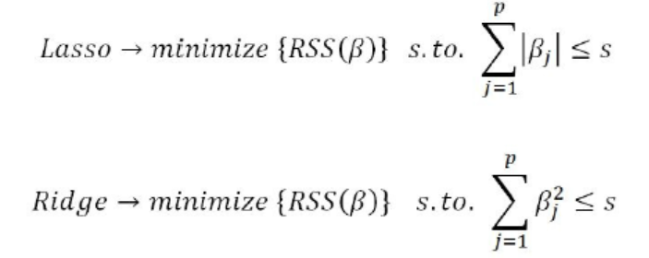
Ridge Regression
Lagrangian multipliers:
For every value of λ, there is an s such that will provide the equivalent equations, as shown for the overall objective function with a penalty factor:

Slide 27
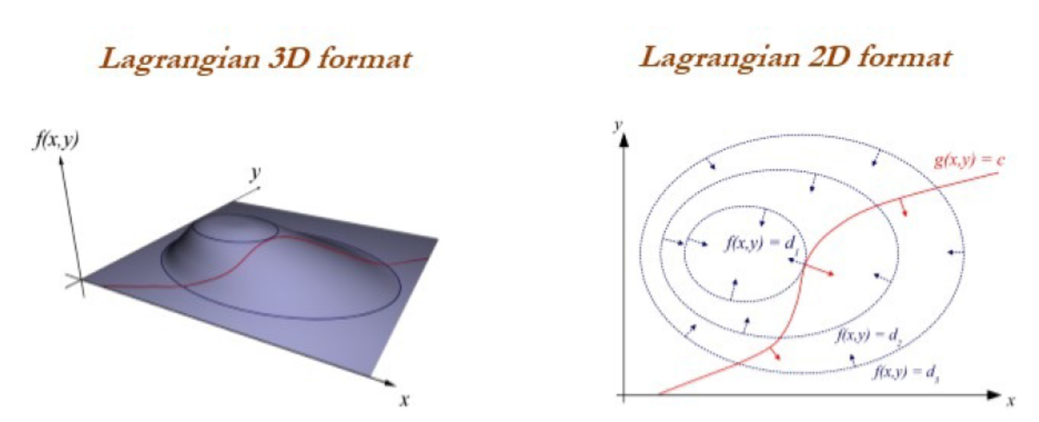
Lagrangian 2D and 3D Formats

Slide 28
Implementation of Ridge Regression Model
Ridge Regression added a term in ordinary least square error function that regularizes the value of coefficients of variables.
This term is the sum of squares of coefficient multiplied by the parameter The motive of adding this term is to penalize the variable corresponding to that coefficient not very much correlated to the target variable.
This term is called L₂ regularization.

Slide 29
Implementation of Ridge Regression Model
# import ridge regression from sklearn library
from sklearn.linear_model import Ridge
# Train the model
ridgeR = Ridge(alpha = 1)
ridgeR.fit(x_train, y_train)
y_pred = ridgeR.predict(x_test)
# calculate mean square error
mean_squared_error_ridge = np.mean((y_pred - y_test)**2)
print(mean_squared_error_ridge)
# get ridge coefficient and print them
ridge_coefficient = pd.DataFrame()
ridge_coefficient["Columns"]= x_train.columns
ridge_coefficient['Coefficient Estimate'] = pd.Series(ridgeR.coef_)
print(ridge_coefficient)

Slide 30
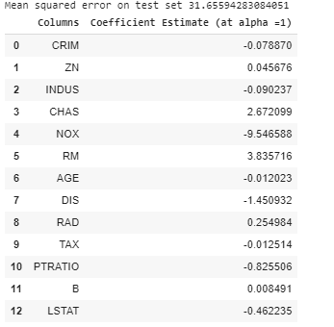
Implementation of Ridge Regression Model

Slide 31
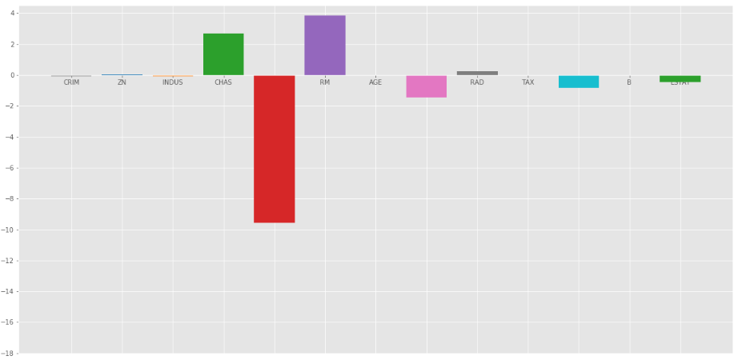
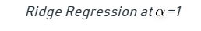
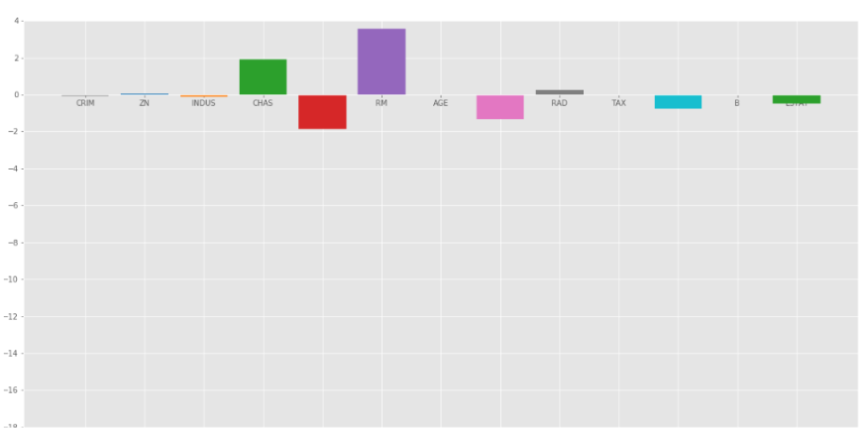
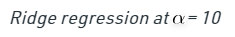
Implementation of Ridge Regression Model

Slide 32
Implementation of Ridge Regression Model
As we can observe from the above plots that alpha helps in regularizing the coefficient and make them converge faster.
Notice that the above graphs can be misleading in a way that it shows some of the coefficients become zero.
In Ridge Regularization, the coefficients can never be 0, they are just too small to observe in above plots.

Slide 33
Ridge Regression
Ridge Regression :
works well in situations where the least squares estimates have high variance.
Advantage:
best subset selection, which requires 2P models.
model-fitting procedure can be performed very quickly.
Disadvantage:
include all the predictors and shrinks the weights according to their importance, but it does not set the values exactly to zero in order to eliminate unnecessary predictors from models

Slide 34
Lasso Regression:
Lasso Regression is similar to Ridge regression except here we add Mean Absolute value of coefficients in place of mean square value.
Unlike Ridge Regression, Lasso regression can completely eliminate the variable by reducing its coefficient value to 0.
The new term we added to Ordinary Least Square(OLS) is called L₁ Regularization.
Models generated from lasso are very much like subset selection, hence they are much easier to interpret than those produced by ridge regression.

Slide 35
Implementation of Lasso Regression
# import Lasso regression from sklearn library
from sklearn.linear_model import Lasso
# Train the model
lasso = Lasso(alpha = 1)
lasso.fit(x_train, y_train)
y_pred1 = lasso.predict(x_test)
# Calculate Mean Squared Error
mean_squared_error = np.mean((y_pred1 - y_test)**2)
print("Mean squared error on test set", mean_squared_error)
lasso_coeff = pd.DataFrame()
lasso_coeff["Columns"] = x_train.columns
lasso_coeff['Coefficient Estimate'] = pd.Series(lasso.coef_)
print(lasso_coeff)

Slide 36
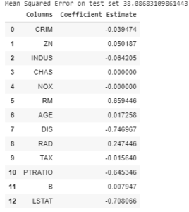
Output: The value of MSE error and the dataframe with Lasso coefficients.

Slide 37
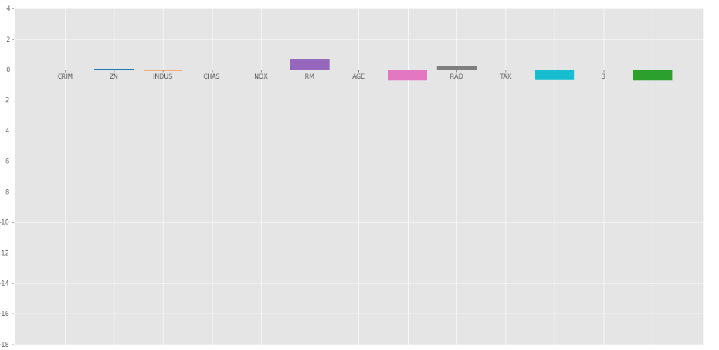
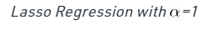
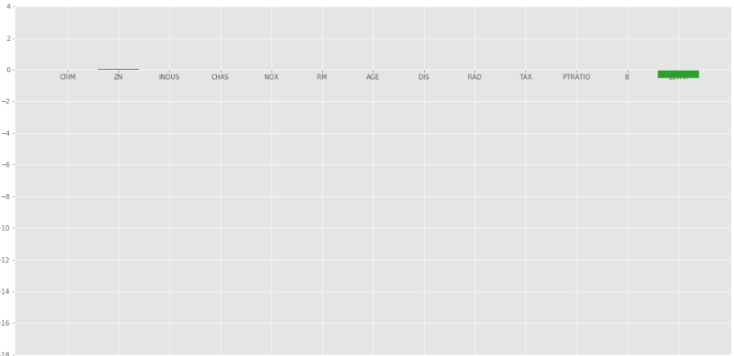
Implementation of Lasso Regression

Slide 38
Conclusion- Ridge & Lasso Regression
Ridge Regression
Adds L₂ regularization penalty term to loss function. This term reduces the coefficients but does not make them 0 and thus doesn’t eliminate any independent variable completely.
It can be used to measure the impact of the different independent variables.
Lasso Regression
Adds L₁ regularization penalty term to loss function.
This term reduces the coefficients as well as makes them 0 thus effectively eliminate the corresponding independent variable completely.
It can be used for feature selection etc.

Slide 39
Logistic Regression Vs Random Forest
Logistic Regression is used widely for solving Industry scale problems as it’s easy to implement and it generally doesn't give you discrete output and gives Probability associated with each output.
The logistic regression algorithm is robust to a small noise in the data and is not particularly affected by small cases of multi-collinearity. We can use many metrics for evaluation but let’s consider Recall for True Positive and F1 score (Harmonic Mean for Recall and Precision)
Random Forest Classifier is more of Accuracy focused algorithm and is best till it’s used with proper fit, else it gets overfat quickly.
Random selection in individual decision trees of RFC can capture more complex feature patterns to provide the best accuracy.
RFC can also tell us how much each feature contributes to class prediction using Feature Importance and tree graphs for better interpretation.

Slide 40
Logistic Regression Vs Random Forest
Summary:
Overall saying Random Forest Classifier performs better with more categorical data than numeric and logistic regression is a little confusing when comes to categorical data So.
If the dataset has more Categorical data and consists of outliers it is better to use Random Forest Classifier.

Slide 41
Logistic Regression Vs Random Forest
According to Google:
Logistic regression performs better when the number of noise variables is less than or equal to the number of explanatory variables and the random forest has a higher true and false positive rate as the number of explanatory variables increases in a dataset.

Slide 42
Maximum likelihood Estimation
Logistic regression works on the principle of maximum likelihood estimation;
Maximum likelihood estimation is a method of estimating the parameters of a model given observations, by finding the parameter values that maximize the likelihood of making the observations.
This means finding parameters that maximize the probability p of event 1 and (1-p) of non-event 0, as you know:
probability (event + non-event) = 1

Slide 43
Terminology involved in Logistic Regression
Logistic regression is favorite ground for many interviewers to test the depth of an analyst with respect to their statistical acumen.
It has been said that, even if someone understands 1,000 concepts in logistic regression, there would always be a question 1,001 from an interviewer.
Hence, it would really be worth building knowledge on logistic regression from its fundamentals in order to create a solid foundation

Slide 44
a.) Information value :
This is very useful in the preliminary filtering of variables prior to including them in the model.
IV is mainly used by industry for eliminating major variables in the first step prior to fitting the model, as the number of variables present in the final model would be about 10.
Hence, initial processing is needed to reduce variables from 400+ in number or so.

Slide 45
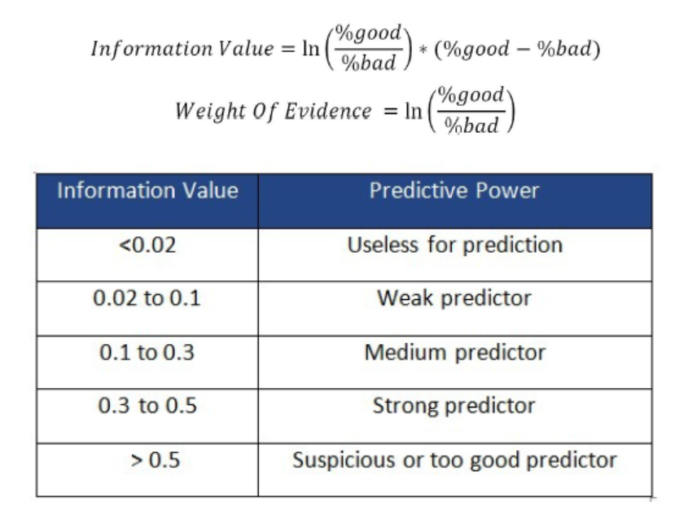
a.) Information value :

Slide 46
b.) Akaike information criteria (AIC):
This measures the relative quality of a statistical model for a given set of data. It is a trade-off between bias versus variance.
During a comparison between two models, the model with less AIC is preferred over higher value.
regularization in logistic regression:
AIC = -2*ln(L) + 2*k
L = Maximum value of Likelihood (log transformation applied for mathematical
convenience)
k = Number of variables in the model

Slide 47
c.) Receiver operating characteristic (ROC) curve
This is a graphical plot that illustrates the performance of a binary classifier as its discriminant threshold is varied.
The curve is created by plotting true positive rate (TPR) against false positive rate (FPR) at various threshold values.
Optimum threshold = Threshold where maximum (sensitivity + specificity) is possible

Slide 48
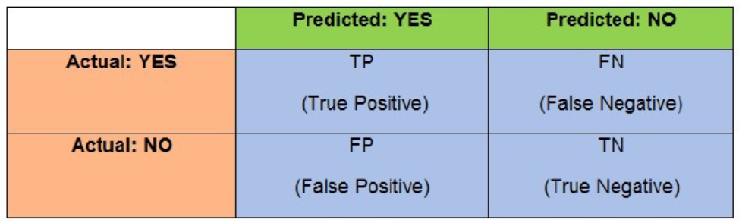
To visualize the confusion matrix

Slide 49
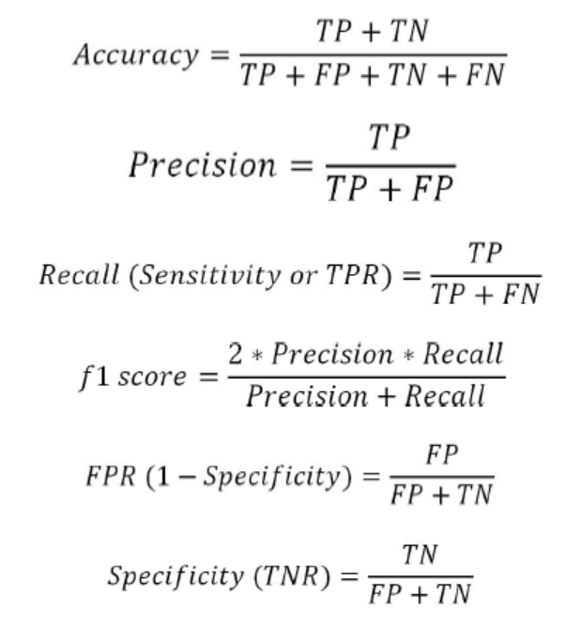
To visualize the confusion matrix

Slide 50
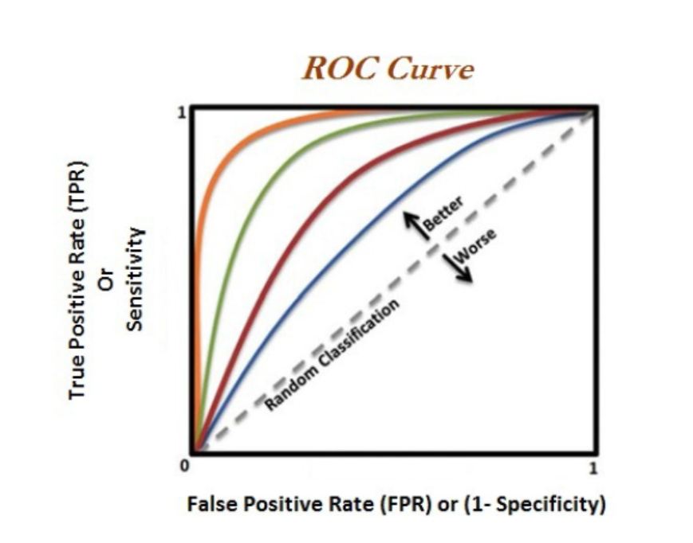
ROC - Curve

Slide 51
Rank ordering:
After sorting observations in descending order by predicted probabilities, deciles are created.
(10 equal bins with 10 percent of total observations in each bin)
By adding up the number of events in each decile, we will get aggregated events for each decile and this number should be in decreasing order, else it will be in serious violation of logistic regression methodology.
why rank ordering is important?
Marketing campaigns where the segments have a higher chance of responding to the campaign.

Slide 52
Concordance/c-statistic
This is a measure of quality of fit for a binary outcome in a logistic regression model.
It is a proportion of pairs in which the predicted event probability is higher for the actual event than non-event.
actual and predicted values are shown with a sample of seven rows.
Actual is the true category, either default or not.
whereas predicted is predicted probabilities from the logistic regression model.

Slide 53
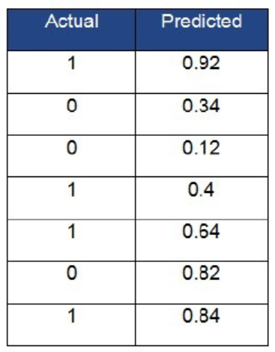
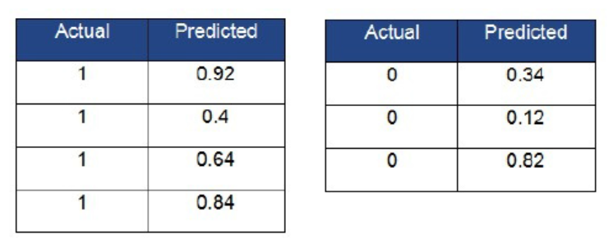
Concordance/c-statistic
Calculate the concordance value.
For calculating concordance,
we need to split the table into two
(each table with actual values as 1 and 0)
and apply the Cartesian product of each row from both tables to form pairs:

Slide 54
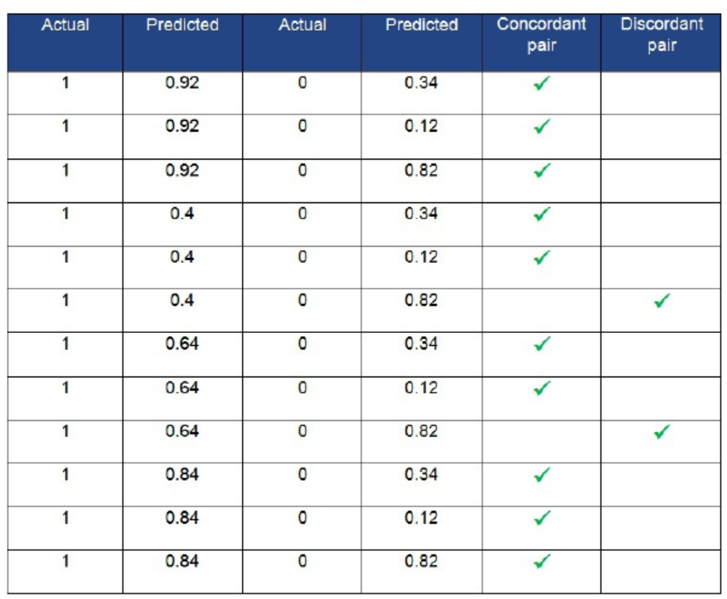
complete Cartesian product has been calculated

Slide 55
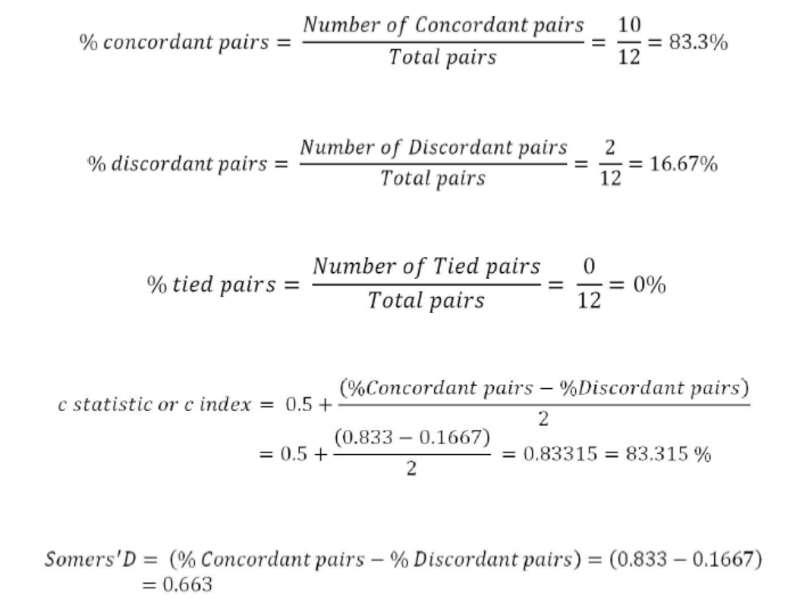
complete Cartesian product has been calculated

Slide 56
C-statistic:
This is 0.83315 percent or 83.315 percent, and any value greater than 0.7 percent or 70 percent is considered a good model to use for practical purposes.

Slide 57
Divergence:
The distance between the average score of default accounts and the average score of non-default accounts.
The greater the distance, the more effective the scoring system is at segregating good and bad observations.

Slide 58
K-S statistic:
This is the maximum distance between two population distributions.
It helps with discriminating default accounts from non-default accounts.

Slide 59
Population stability index (PSI):
This is the metric used to check that drift in the current population on which the credit scoring model will be used is the same as the population with respective to development time:
PSI <= 0.1:
This states no change in characteristics of the current population with respect to the development population
0.1 < PSI <= 0.25:
This signifies some change has taken place and warns for attention, but can still be used
PSI >0.25:
This indicates a large shift in the score distribution of the current population compared with development time

Slide 60
Applying steps in logistic regression modeling
The following steps are applied in linear regression modeling in industry:
1. Exclusion criteria and good-bad definition finalization
2. Initial data preparation and univariate analysis
3. Derived/dummy variable creation
4. Fine classing and coarse classing
5. Fitting the logistic model on the training data
6. Evaluating the model on test data

Slide 61
Random forest
very powerful technique which is used frequently in the data science field for solving various problems across industries.
Random forest is an ensemble of decision trees, as we know, logistic regression has very high bias and low variance technique
Decision trees have high variance and low bias, which makes decision trees unstable.
By averaging decision trees, we will minimize the variance component the of model, which makes approximate nearest to an ideal model.

Slide 62
Random Forest
RF focuses on sampling both observations and variables of training data to develop independent decision trees and take majority voting for classification and averaging for regression problems respectively

Slide 63
Random Forest
Random forest is a Supervised Machine Learning Algorithm that is used widely in Classification and Regression problems.
It builds decision trees on different samples and takes their majority vote for classification and average in case of regression.
One of the most important features of the Random Forest Algorithm is that it can handle the data set containing continuous variables as in the case of regression and categorical variables as in the case of classification. It performs better results for classification problems.

Slide 64
Random Forest
Ensemble simply means combining multiple models. Thus a collection of models is used to make predictions rather than an individual model.
Ensemble uses two types of methods:
1. Bagging– It creates a different training subset from sample training data with replacement & the final output is based on majority voting.
For example: Random Forest.
2. Boosting– It combines weak learners into strong learners by creating sequential models such that the final model has the highest accuracy.
For example: ADA BOOST, XG BOOST

Slide 65
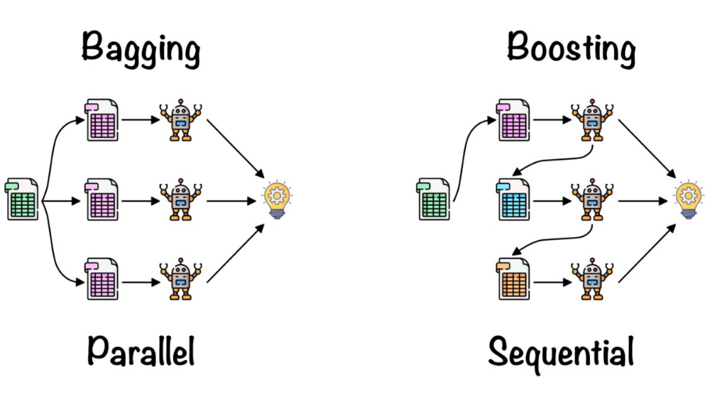

Slide 66
Bagging
Bagging, also known as Bootstrap Aggregation is the ensemble technique used by random forest.
Bagging chooses a random sample from the data set.
Hence each model is generated from the samples (Bootstrap Samples) provided by the Original Data with replacement known as row sampling.
This step of row sampling with replacement is called bootstrap.
Now each model is trained independently which generates results.
The final output is based on majority voting after combining the results of all models.
This step which involves combining all the results and generating output based on majority voting is known as aggregation.

Slide 67
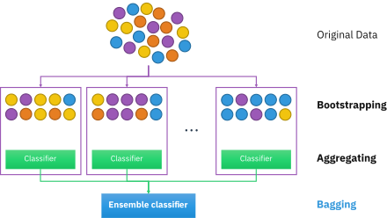
Bagging

Slide 68
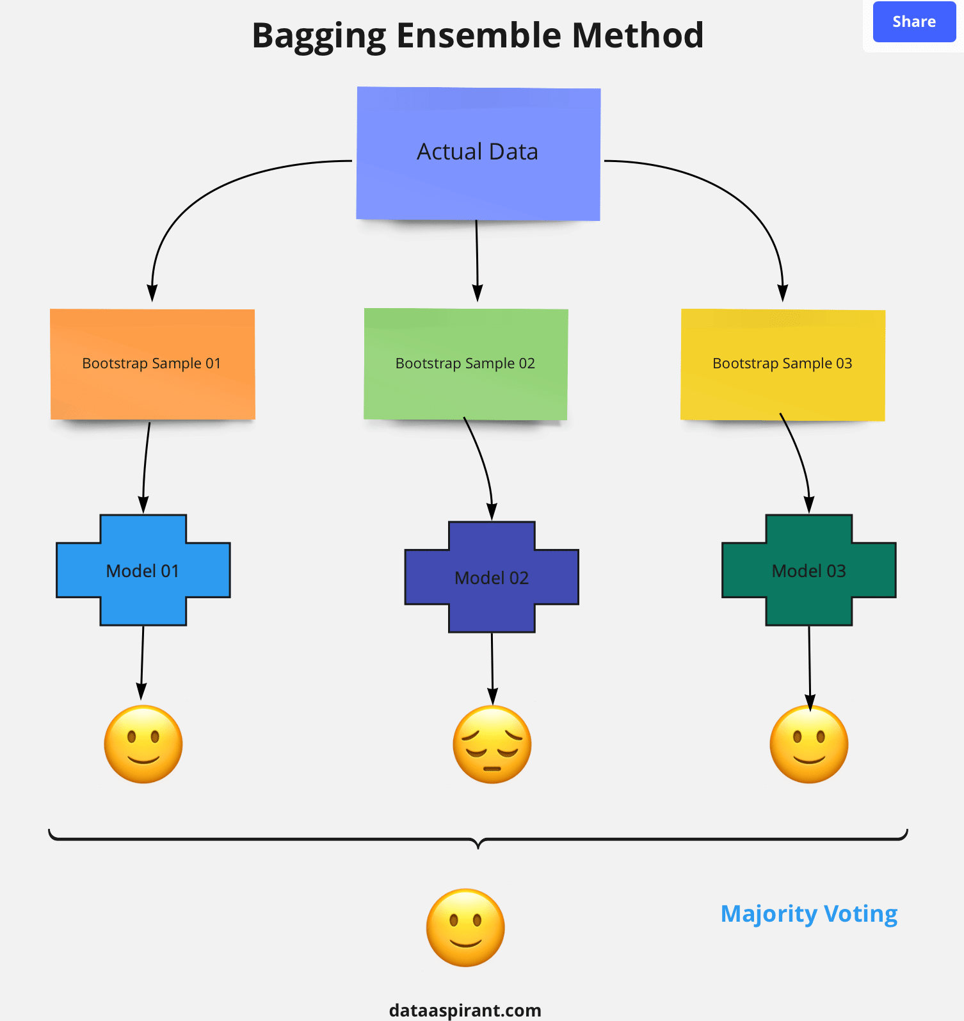

Slide 69
Steps involved in random forest algorithm:
Step 1: In Random forest n number of random records are taken from the
data set having k number of records.
Step 2: Individual decision trees are constructed for each sample.
Step 3: Each decision tree will generate an output.
Step 4: Final output is considered based on Majority Voting or Averaging for
Classification and regression respectively.

Slide 70
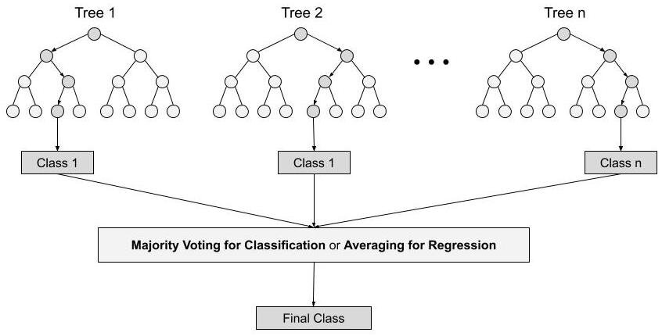

Slide 71
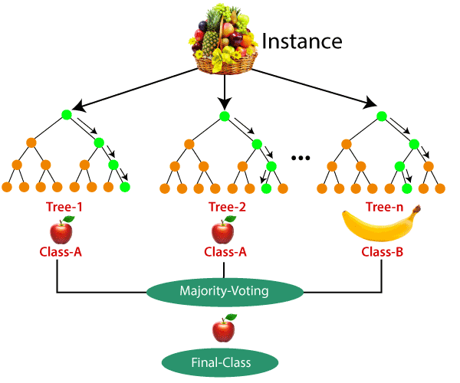

Slide 72
Important Features of Random Forest
Diversity-
Not all attributes/variables/features are considered while making an individual tree, each tree is different.
2. Immune to the curse of dimensionality-
Since each tree does not consider all the features, the feature space is reduced.
3. Parallelization-
Each tree is created independently out of different data and attributes. This means that we can make full use of the CPU to build random forests.
4. Train-Test split-
In a random forest we don’t have to segregate the data for train and test as there will always be 30% of the data which is not seen by the decision tree.
5. Stability-
Stability arises because the result is based on majority voting/ averaging.

Slide 73
Decision trees | Random Forest
1. Decision trees normally suffer from the problem of overfitting if it’s allowed to grow without any control. | 1. Random forests are created from subsets of data and the final output is based on average or majority ranking and hence the problem of overfitting is taken care of.
2. A single decision tree is faster in computation. | 2. It is comparatively slower.
3. When a data set with features is taken as input by a decision tree it will formulate some set of rules to do prediction. | 3. Random forest randomly selects observations, builds a decision tree and the average result is taken. It doesn’t use any set of formulas.

Slide 74
Decision Trees - Use Cases
This algorithm is widely used in E-commerce, banking, medicine, the stock market, etc.
For example:
In the Banking industry it can be used to find which customer will default on the loan.

Slide 75
Advantages of Random Forest Algorithm
1. It can be used in classification and regression problems.
2. It solves the problem of overfitting as output is based on majority voting
or averaging.
3. It performs well even if the data contains null/missing values.
4. Each decision tree created is independent of the other thus it shows the
property of parallelization.
5. It is highly stable as the average answers given by a large number of trees
are taken.

Slide 76
Disadvantages of Random Forest Algorithm
Random forest is highly complex when compared to decision trees where decisions can be made by following the path of the tree.
2. Training time is more compared to other models due to its complexity.
Whenever it has to make a prediction each decision tree has to generate
output for the given input data.

Slide 77
Comparison of logistic regression with random forest
In the logistic regression model, it is the p-value (minimum is a better predictor), and for random forest it is the mean decrease in Gini (maximum is a better predictor).
Many of the variables are very much matching in importance like, status_exs_accnt_A14, credit_hist_A34, Installment_rate_in_percentage_of_disposable_income, property_A_24, Credit_amount, Duration_in_month, and so on

Slide 78
Grid search on random forest
changing various hyperparameters with the following settings.
Number of trees is (1000,2000,3000)
Maximum depth is (100,200,300)
Minimum samples per split are (2,3)
Minimum samples in leaf node are (1,2)
Import Pipeline as follows:
>>> from sklearn.pipeline import Pipeline
>>> from sklearn.model_selection import train_test_split,GridSearchCV

Slide 79
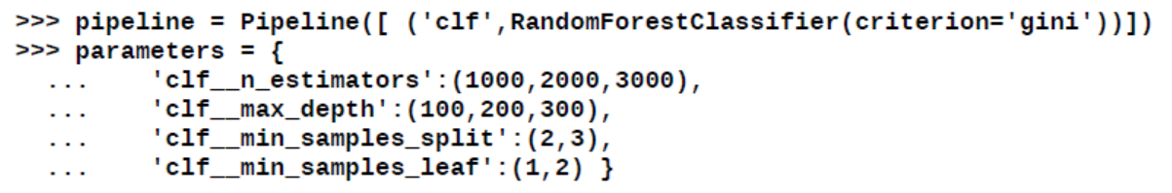
Grid search on random forest
The Pipeline function creates the combinations which will be applied one by one sequentially to determine the best possible combination:

Slide 80
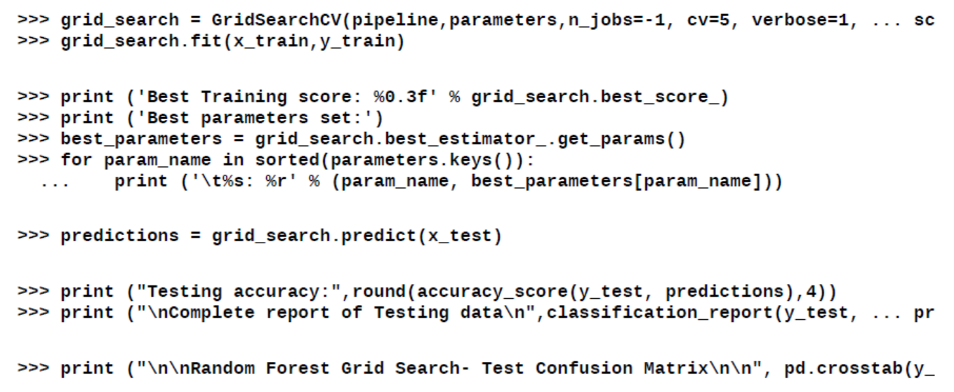
Grid search on random forest

Slide 81
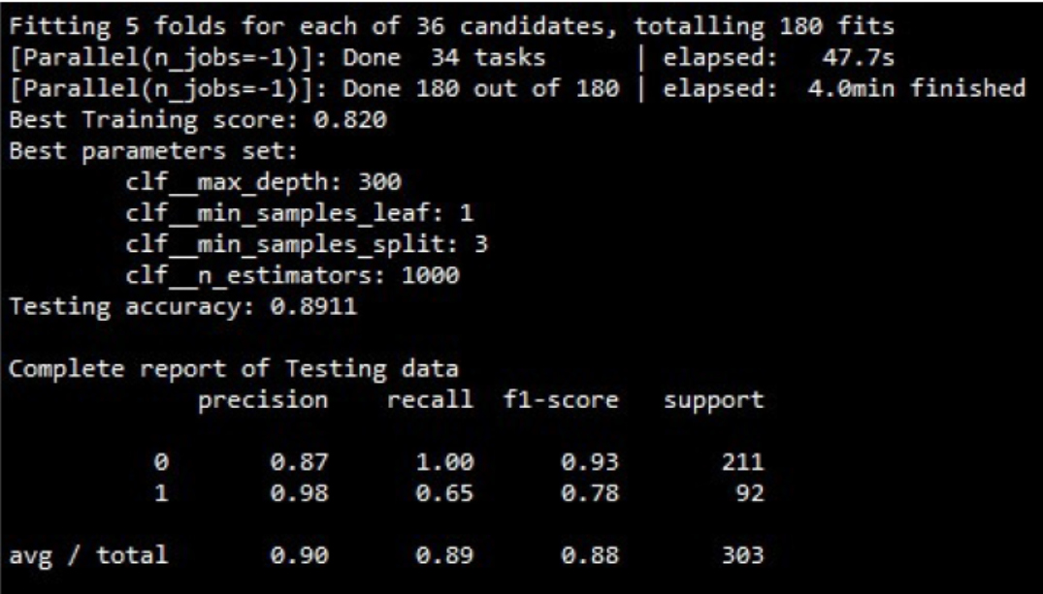
Grid search on random forest

Slide 82
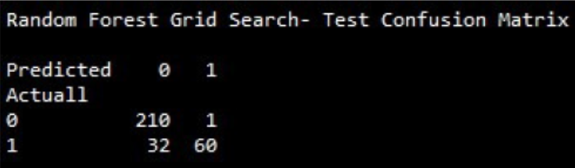
Grid search on random forest

Slide 83
Grid search on random forest
From the result of grid search, it is apparent that best test accuracy is 0.8911 or 89.11 percent.
which is about a 10 percent uplift from the logistic regression model.
By predicting 10 percent better accuracy, losses incurred due to sanctioning loans to bad customers will be greatly decreased

Slide 84
Grid search on random forest
In a simple random forest model, train accuracy is 97.4 percent, but test accuracy is comparatively lower at 85.5 percent.
In grid search methodology, train accuracy is 82 percent, but test accuracy is 89.11 percent.
This highlights the issue of overfitting by building a model on single data compared with a five-fold cross validation methodology used in grid search.
Hence, it is advisable to perform cross-validation to avoid over-fitting problems and ensure robustness in machine learning models.

Slide 85
Variable importance plot
Variable importance plot provides a list of the most significant variables in descending order by a mean decrease in Gini.
The top variables contribute more to the model than the bottom ones and also have high predictive power in classifying default and non-default customers.
grid search does not have variable importance functionality in Python scikit-learn

Slide 86
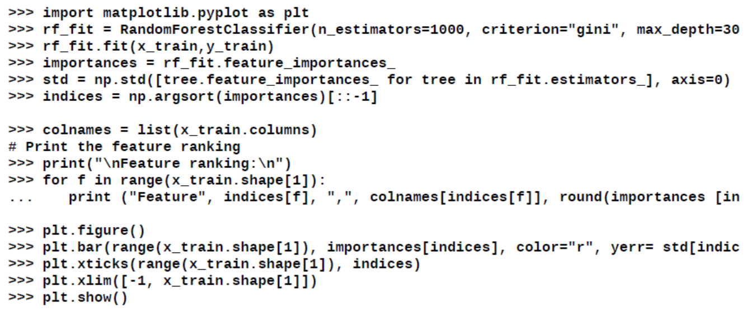
Variable importance plot

Slide 87
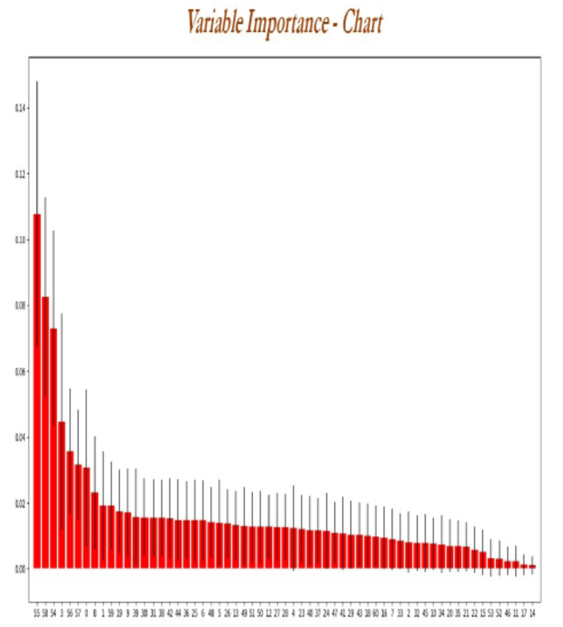

Slide 88
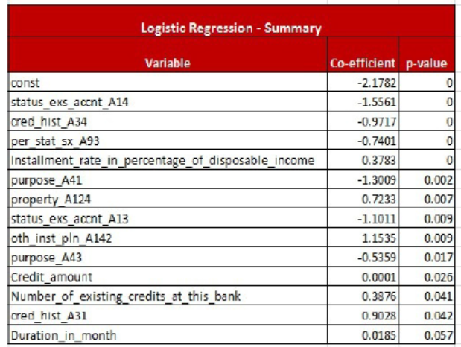
Comparison of logistic regression with random forest

Slide 89
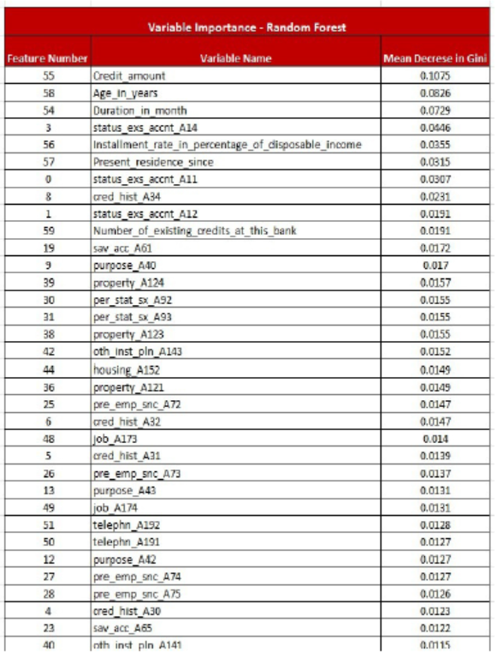
Comparison of logistic regression with random forest

